Slide 1
CS188: Distributed Systems Lecture 1
Spring 2019
Ravi Netravali

Slide 2


What is a Distributed System?
Multiple interconnected computers that cooperate to provide some service
Network

Slide 3
Today’s Agenda
Why study distributed systems?
Course syllabus and logistics
Questions/concerns about enrollment

Slide 4

Why study distributed systems?
They are everywhere!

Slide 5
Example distributed system: Google search
What are Google’s goals/objectives when serving search query results to users?
Resilience to failures (availability)
Low latency
Support for large load
Easy access to most relevant results
What distributed systems are necessary to achieve these goals?

Slide 6
Google in 1997

Slide 7

Geo-Distributed Services

Slide 8
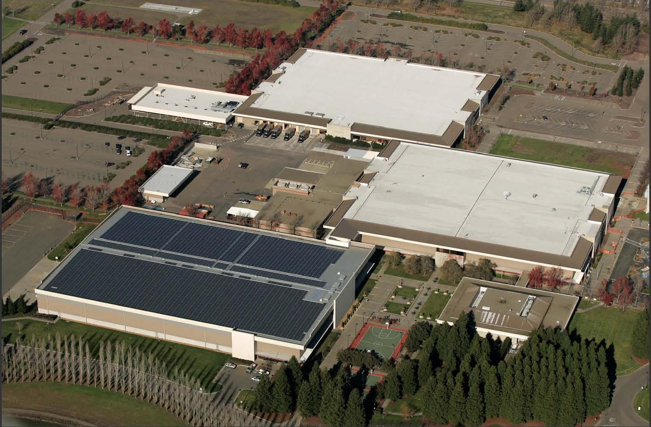
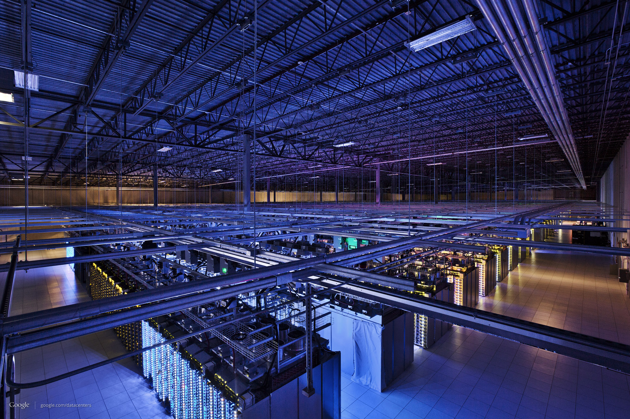
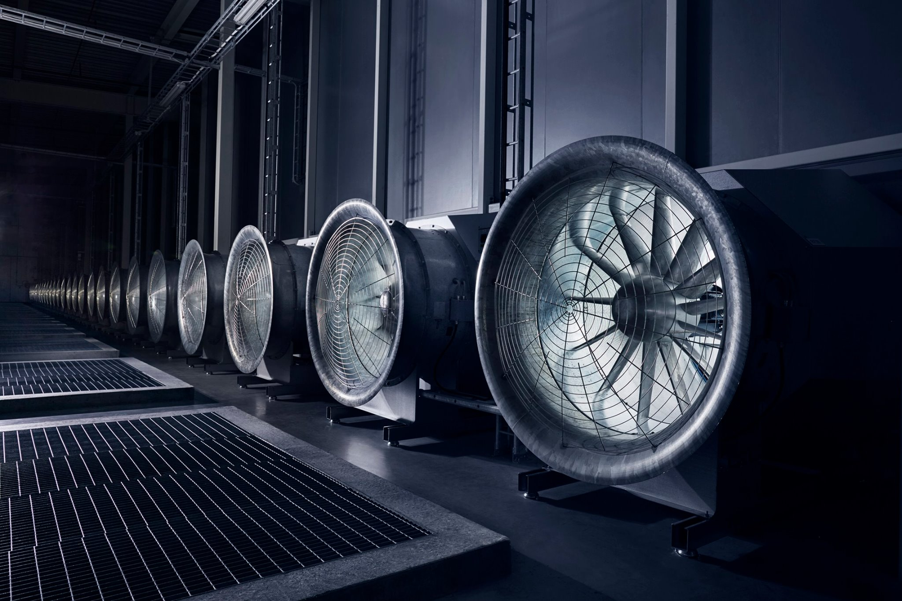
Data Centers
Spread services and data storage/processing across 100s of thousands of machines

Slide 9
Google Today

Slide 10
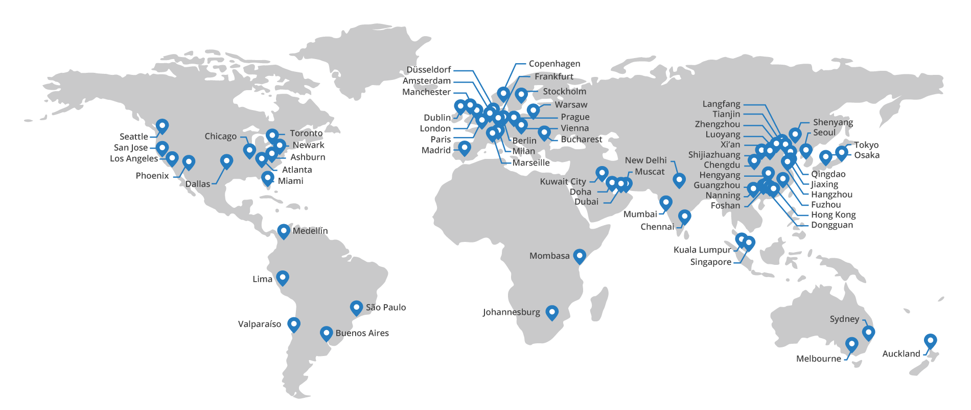
Non-Data Center Servers
Cloudflare edge servers

Slide 11
Other Distributed Systems Examples
Internet and data center network
Domain Name System (DNS)
Operating System for multi-core processors
World Wide Web
Multiplayer Games

Slide 12
Why do we need Distributed Systems?
Handle geographic separation
Facebook, Google, and Amazon customers span the planet
Build reliable systems with unreliable components
Aggregate systems for higher capacity
CPU cycles, disks, memory, network bandwidth
Cost grows non-linearly
Customize computers for specific tasks (e.g., microservices)
Cache server, load balancer, ads, speech-to-text conversion

Slide 13
Why study distributed systems?
They are everywhere!
Hard to develop and reason about

Slide 14
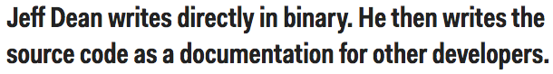
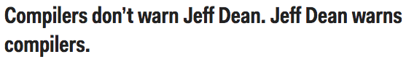
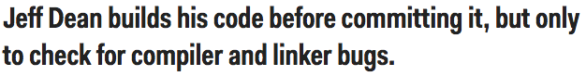
Jeff Dean “Facts”

Slide 15
Challenge 1: Partial failures
“A distributed system is one where you can’t get your work done because some machine you’ve never heard of is broken.” – Leslie Lamport

Slide 16
Facebook’s Pineville Data Center
Contents:
200K+ servers
500K+ disks
10K network switches
300K+ network cables
At any time, high likelihood that some components are not functioning correctly!
Takeaway: design distributed systems assuming failures will happen

Slide 17
Challenge 2: Ambiguous failures
If a server doesn’t reply, how can you distinguish between:
Server failure
Network failure
Neither; they are both just slow
Cannot make assumptions about incurred delays

Slide 18
Challenge 3: Concurrency
Why not partition users across machines?
Shared State

Slide 19
Challenge 3: Concurrency
Goal: ensure consistency of distributed state in the face of concurrent operations
Use OS concurrency mechanisms like locks, mutex, cv, and semaphore?
Restricted to single process! We need service to share locks across servers
Challenge: cross-server synchronization must operate with slow/unreliable machines and network

Slide 20
Other Challenges
Design/Evaluation at scale
Example: Amazon redesigns software services for every order of magnitude change in scale
Comprehensive testing
Impossible to test/reproduce all possible scenarios
Even if enumerated, cannot test at scale
Security
Example: malicious modification of network traffic

Slide 21

Class Objectives
Goal: unify several machines to provide shared service
Enable concurrent use of state/resources, and hide failures
Automate heavy lifting so developers don’t have to
Applications
X
X

Slide 22
Contrast with CS111 (OS)
Distributed Systems: give one app the illusion that it is running on a single machine (though it is using many)
Operating Systems: give every application the illusion that it is running on its own machine (though they share a machine)
App₁
App₂
App₃

Slide 23
Class Outcomes
As developers of distributed systems: be able to reason about uncertainty
As users of distributed systems: be able to identify guarantees and properties offered by a system
When will it work well?
When will it break?

Slide 24
Concrete Topics
Synchronization (clock sync, logical clocks)
Failure recovery (snapshotting, primary-backup)
Consistency (linearizability, eventual, causal)
Consensus protocols (Paxos, Raft)
Distributed transactions and locking

Slide 25
Course Logistics

Slide 26
Staff
Instructor: Ravi Netravali
Assistant Professor, PhD from MIT in 2018
Research interests: networks/distributed systems; performance and debugging of large-scale web and machine learning systems
Office hours: Monday 2pm-4pm
TAs: Spyros Mastorakis and Shaghayegh Mardani
PhD students in Computer Science
Research interests: Spryos—named data networking, Shagha—web systems
Office hours: Spyros (Tuesday 9am-11am), Shagha (Wednesday 3pm-5pm)

Slide 27
Prerequisites and Enrollment
No formal prerequisites…
But! Strongly encouraged to have taken CS111 (operating systems) and CS118 (networks)
Please see me if you have not taken these courses, particularly CS111
Class target size is 80 for first offering
No PTEs this offering
Will be offered regularly moving forward

Slide 28
Course Website
http://web.cs.ucla.edu/~ravi/CS188_S19/

Slide 29
Course Components
Attendance: lectures and discussion
Not mandatory, but highly encouraged
Assignments: 4 programming labs
Exams: “midterm”

Slide 30
Discussion sections
Used in three ways:
Explain project specifications
Recap lecture material
Discuss questions and example problems to reinforce lecture material
Please consistently attend one
Not mandatory, but you are encouraged to attend

Slide 31
Programming Labs
4 assignments in total
MapReduce master
Primary backup replication
Paxos
Scaling via sharding
First one is individual, rest are in groups of 2
Email staff your group members by 4/10
Trouble finding partners? → post to Piazza

Slide 32
Programming Labs
Program in Go
https://tour.golang.org/welcome/
Syntactically similar to C/C++ (good for systems programming)
Also includes memory safety, garbage collection, concurrency support
Test cases are included in the assignment
Run locally as set of processes exchanging RPCs
You need to understand test cases to debug!

Slide 33
Assignment Policies
Submission: private GitHub repositories to each group
We can track your progress, commits, etc.
Logistics
Due by 10pm on deadline date
4 late days across projects 2-4 (per group)
Cannot submit more than 5 days late; 50% if late days expended
Collaboration
Good: clarify problem or discuss Go syntax
Bad: discuss solutions

Slide 34
Assignment 1
Out today and due Friday, 4/12 by 10pm
No late days!
Submission
Fork starter code into private github repo
Submit repo via submission form (linked in assignemnt)

Slide 35
Exams
Midterm
In class on Monday, May 20
Covering core concepts such as consistency, failure recovery, etc.
No case studies
No makeup exams (unless dire circumstances)
Schedule interviews and other commitments appropriately

Slide 36
Grading breakdown
Programming Labs (70%)
Assignment 1: 10%
Assignments 2-4: 20% each
Midterm (30%)

Slide 37
Tips for success
Start programming labs early!!!
Attend lectures and discussions
Ask questions when something is unclear (in lecture, discussion, office hours, or on Piazza)

Slide 38
Heads up
This is the first offering of the course so…
…expect a few hiccups
…don’t hesitate to provide suggestions!

Slide 39
Todo for next class
Learn Go and start assignment 1
Tutorial on Go at discussion section on Friday
Subscribe to Piazza
Find a partner for group assignments 2-4

